Slide 1


Qoli Ndzalama Ngoveni
August 06th, 2024

Slide 2

Outline
Executive Summary
Introduction
Methodology
Results
Conclusion
Appendix

Slide 3
Executive Summary
Approach to this analysis integrated data webscraping from SpaceX website and data cleaning and preprocessing into a relational database.
Exploratory data analysis using SQL and interactive data visualizations with folium and dash
Evaluation of different machine learning models using GridSearchCV to identify the best-performing model for this analysis.
Decision Tree model is the best-performing model with 80% precision and recall, and thus preferred for our analysis.
PayloadMass, flight numbers, orbit type, booster versions, and launch site influence the successful landing of Falcon 9 rocket.

Slide 4
Introduction
SpaceX advertised Falcon 9 which cost 62 million dollars to launch compared to the 165 million dollar by other providers.
Cost-saving by SpaceX is because they can reuse their initial stage.
Hence, determining the success of landing for the first stage is imperative to estimate the cost of launch.
This analysis presentation will determine if the first stage will land and evaluates factors influencing successful rocket landing.
Statistical approaches such as Exploratory Data Analysis, Data Visualizations, and Machine Learning shall be integrated to answer the questions of interest.

Slide 5

Section 1

Slide 6
Methodology
Executive Summary
Data collection methodology:
Data for this analysis was obtained from the SpaceX website and Wikipedia through webscraping and requests API.
Perform data wrangling
The dataset was filtered to show only the records of Falcon 9.
Normalized landing outcome into a class of integer( class 1 mean success landing, whereas class 0 means failure landing)
Null values were replaced with their mean values and the datatype changed into float and integer for easy analysis
Perform exploratory data analysis (EDA) using visualization and SQL

Slide 7
Methodology
Executive Summary
Perform interactive visual analytics using Folium and Plotly Dash
Perform predictive analysis using classification models
Grid searched different classification methods to find the best performing classification model
Visualized search outputs in a distribution plots

Slide 8
Data Collection
Data Source:
Space X Launch site
SpaceX Wikipedia
GET REQUEST
SpaceX website and Wikipedia
Parser data into dataframe
Extract tables using Beautiful Soup

Slide 9
Data Collection – SpaceX API
Define URL and assign it to the object
Send requests to the URL
If the response is 200, a request has been sent successfully
Normalize the dataset into a data frame
Define SpaceX URL:
spacex_url="https://api.spacexdata.com/v4/launches/past"
Send a request and print a response:
Response = requests.get(spacex_url)
Response.status
Parse the databaset into dataframe using json.normalize:
Data= pd.json_normalize(json)

Slide 10
Data Collection - Scraping
Send a request and wait for a response
Parse the response into HTML parsers
Extract relevant table from parsed dataset
Add columns into the data frame
Send a request using requests.get() syntax
Parse the requested data into BeautifulSoup: soup=BeautifulSoup(data, ‘html parser’)
Extract tables from the soup:
Table= soup.table
Create and add a columns to the dataset

Slide 11
Data Wrangling
Filtered database to show Falcon 9 records only
Identified missing values in the dataset using df.isnull() syntax
Replaced null values using df[‘col’].replace(np.nan, mean, inplace=True) function by the mean of the column of interest
Verified data types (df.dtype(), converted True and False values into interger of 1 0r 0.
Identify missing values:
data_falcon_9.isnull().sum()
Filter the database to show falcon 9 records:
data_falcon9 = df[df['BoosterVersion']== 'Falcon 9’]
Calculate the means of the column(s) with missing value:
data_falcon_9[‘PayloadMass’].mean()
Replace the null value with the mean value: df['Orbit'].value_counts().reset_index()

Slide 12
EDA with Data Visualization
Two types of data visualization plots are integrated in this analysis:
1. Cat and Scatter plots
Evaluate the influence of flight numbers for success at a specific launch site
Evaluate the influence of flight number for success at a specific orbit type
Compares payload masses launched at different launching stations/sites
Evaluate the influence of payload mass for success to a specific orbit type
2. Bar plot
Evaluate the yearly trend of launch success between 2010-2020
Compares the success rate of launches per specific orbit type

Slide 13
EDA with SQL
Displayed names of unique launch site: (%sql SELECT DISTINCT Launch_Site FROM SPACEXTABLE)
Five record where launch sites begin with ‘CCA’: %sql SELECT * FROM SPACEXTABLE WHERE Launch_Site like 'CCA%' LIMIT (5)
Total PayloadMass carried by booster launched by NASA (CRS): (%sql SELECT SUM(PAYLOAD_MASS__KG_) AS 'NASA (CRS) TOTAL PAYLOAD_KG' FROM SPACEXTABLE WHERE Customer = 'NASA (CRS)’
Average PayloadMass carried by Booster Version F9 V1: %sql SELECT AVG(PAYLOAD_MASS__KG_) AS 'AVG Payload by F9 V1.1' FROM SPACEXTABLE WHERE Booster_Version = 'F9 v1.1’;
Date of the first successfully landing: %sql SELECT Date, Landing_Outcome FROM SPACEXTABLE WHERE Landing_Outcome = 'Success (ground pad)' ORDER BY Date LIMIT (1)
Add the GitHub URL of your completed EDA with SQL notebook, as an external reference and peer-review purpose

Slide 14
EDA with SQL
Name of booster with successfully landing in drone ship and with a PayloadMass > 4000 and <6000 : %sql SELECT Booster_Version, Landing_Outcome,PAYLOAD_MASS__KG_ FROM SPACEXTABLE WHERE Landing_Outcome is 'Success (drone ship)' AND (PAYLOAD_MASS__KG_ BETWEEN 4000 AND 6000
Total number of successfully and failure landing: %sql SELECT Landing_Outcome, COUNT(Landing_Outcome) FROM SPACEXTABLE GROUP BY Landing_Outcome
records which will display the month names, failure landing_outcomes in drone ship ,booster versions, launch_site for the months in year 2015: %sql SELECT substr (Date, 6, 2), Landing_Outcome, Booster_Version, Launch_Site FROM SPACEXTABLE WHERE substr(Date, 1, 4) = '2015';

Slide 15
EDA with SQL
Booster versions that has carried maximum payload mass: %sql SELECT Booster_Version, PAYLOAD_MASS__KG_ FROM SPACEXTABLE WHERE PAYLOAD_MASS__KG_ = (SELECT MAX(PAYLOAD_MASS__KG_) FROM SPACEXTABLE
Rank the count of landing outcomes (such as Failure (drone ship) or Success (ground pad)) between the date 2010-06-04 and 2017-03-20, in descending order : %sql SELECT Date, Landing_Outcome, COUNT(Landing_Outcome) AS 'COUNTS' FROM SPACEXTABLE GROUP BY Landing_Outcome HAVING DATE Between '2010-0-04' AND '2017-03-20' ORDER BY COUNTS DESC
List the records which will display the month names, failure landing_outcomes in drone ship ,booster versions, launch_site for the months in year 2015: %sql SELECT substr (Date, 6, 2), Landing_Outcome, Booster_Version, Launch_Site FROM SPACEXTABLE WHERE substr(Date, 1, 4) = '2015’;

Slide 16
Build an Interactive Map with Folium
Created interactive map using folium.Map() syntax and added:
Folium Circle: Highlighted launch site location by a circle and created a buffer on the map
Folium Marker: Added context to the map like ‘popup’ and ‘label’
Marker Cluster: Allowed visualization of class outcome (class =1 or class=0) from the same coordinate point

Slide 17
Build a Dashboard with Plotly Dash
Two interactive visualizations plots were created:
1. Pie Chart
Evaluate the success of landing Falcon9 from all launch sites.
Evaluate the success and failure rate of landing Falcon 9 from all launching sites and from a individual launch site.
2. Scatter Plot
Evaluate payload mass correlations with the success outcome for specific launch site
Evaluate mission outcome per booster version

Slide 18
Predictive Analysis (Classification)
Logistic Regression, Decision Tree, Support Vector Machine (SVM) and K-Nearest Neighbor (KNN) models were evaluated for best-performing models to predict future landing of Falcon 9 using the below chart flow:
Define Parameters for each model to be evaluated
Use GridSearchCV to find the best parameter
Fit the training data into the model object created:
(lr = lr.fit(x_train, y_train)
Build model object (EG. svm= SVM())
Compare scores for training and testing data and plot a bar graph
Find the best parameters using best_prama syntax():
Find the accuracy score using the predicts and actually value:
accuracy_score(yhat, y_test)
Predict the outcome for test data:
Yhat = lr.predict(x_test)
Find the best score for training data using best_score syntax():

Slide 19
Results
Exploratory data analysis results
Interactive analytics demo in screenshots
Predictive analysis results

Slide 20

Section 2

Slide 21
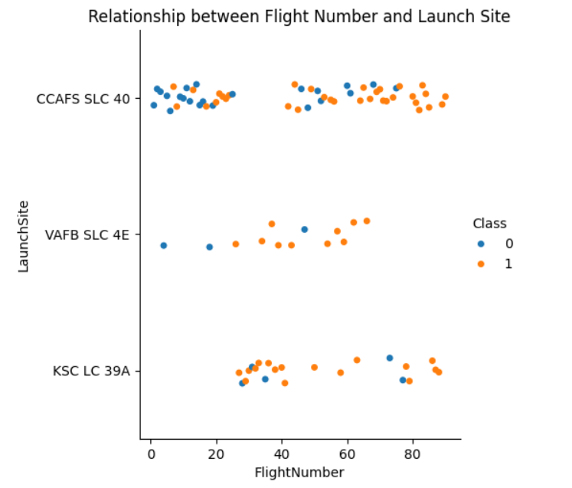
Flight Number vs. Launch Site
As flight number increases high success launch for all launch site
Frequent flights were launched at the CCAFS SLC 40 site with ~50% success
Although, a great proportion of successful flights are recorded for the KSC LC 39A site

Slide 22
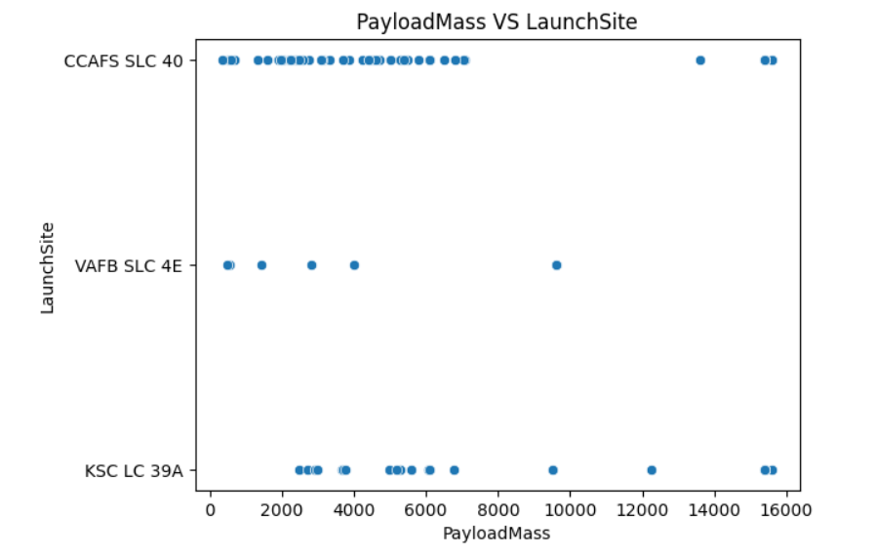
Payload vs. Launch Site
Fewer rockets were launched from VAFB SLC 4E
With a maximum payload mass of 10000kg launched from VAFB SLC 4E site
Maximum payload mass of 16000kg was launched from CCAFS SLC 40 and KSC LC 39A launching sites

Slide 23
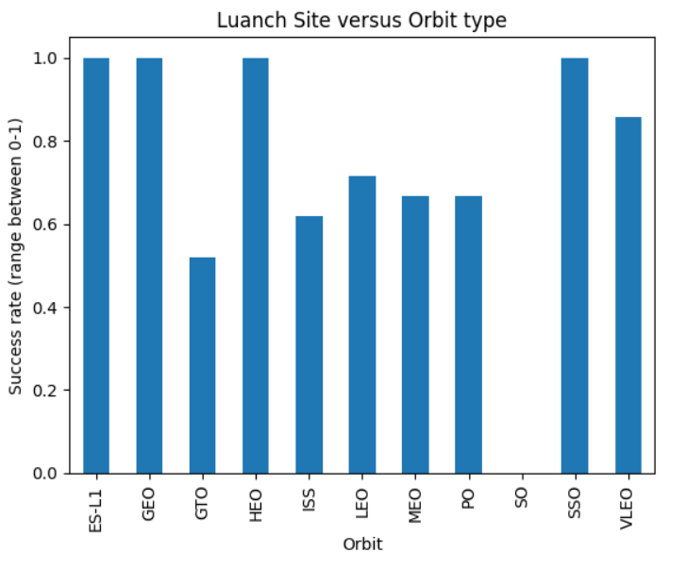
Success Rate vs. Orbit Type
High success landing rate for ES-L1, GEO, HEO and SSO orbits
Medium success rate (about 50% success) for GTO ISS, LEO, MEO, PO orbits
Zero success rate for rockets launched to the SO orbit

Slide 24
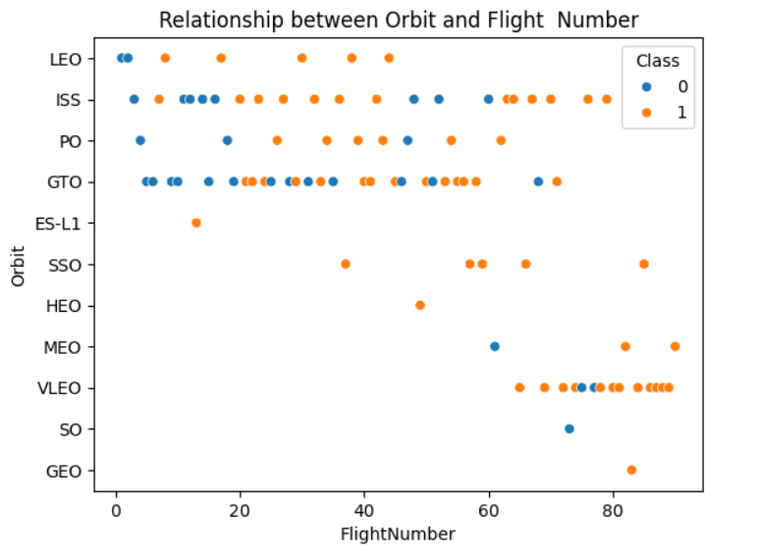
Flight Number vs. Orbit Type
Correlation scatter plot of flight number versus orbit type
LEO, SSO, PO, VLEO and ISS orbits show a great increase in rocket launch success with increasing flight numbers.
Whereas, GTO orbit shows a poor positive correlation between the flight number and success landing outcome

Slide 25
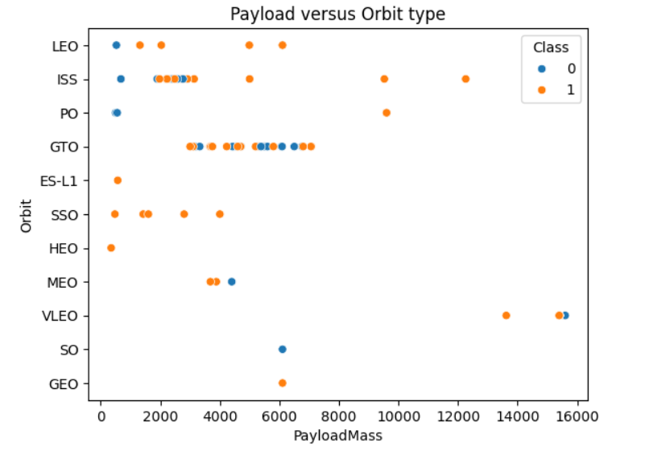
Payload vs. Orbit Type
Correlation scatter plot of payload mass versus orbit type:
Increasing payload mass proves success in landing rate for ISS, LEO, SSO and PO orbits.
Whereas, increasing payload mass for GTO orbit has proven not to influence the landing outcome.
Maximum payload mass of 6000kg was launched to the SO, MEO and GEO orbits.

Slide 26
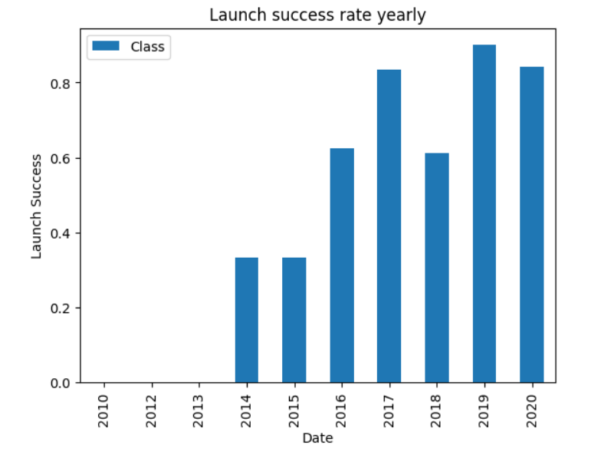
Launch Success Yearly Trend
Gradually increase in launch success between 2014-2020
Highest rate of success experienced in 2019
No record of successful launch between 2010-2013 period
This period mostly represents the attempt period/failure outcome

Slide 27
All Launch Site Names
SpaceX Launch Sites:
CCAFS LC-40
VAFB SLC-4E
KSC LC-39A
CCAFS SLC-40

Slide 28
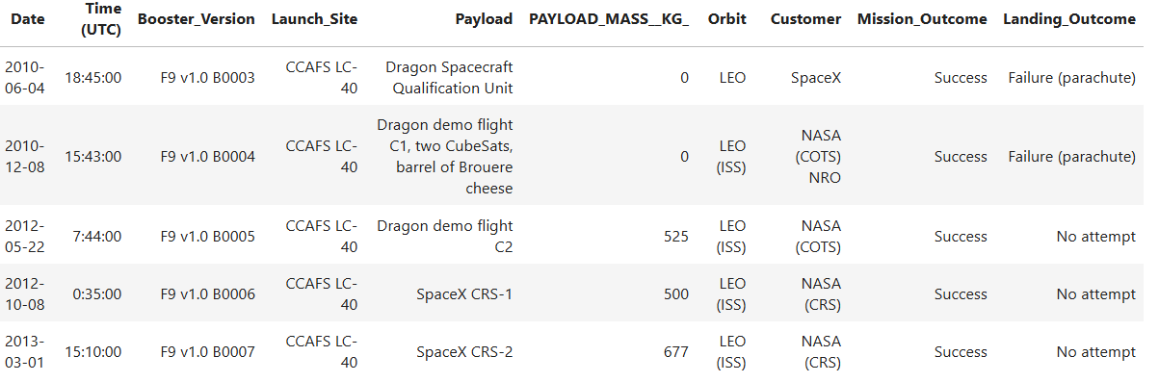
Launch Site Names Begin with 'CCA'
Five (5) records where launch sites begin with `CCA`:

Slide 29
Total Payload Mass
Total payload mass carried by NASA Booster:
45596 kilograms (kg)

Slide 30
Average Payload Mass by F9 v1.1
The average payload mass carried by booster version F9 v1.1:
2928.4 kg

Slide 31
First Successful Ground Landing Date
The first successful landing outcome on the ground pad carried by SpaceX was on the:
22 December 2015 (2015-12-22)

Slide 32
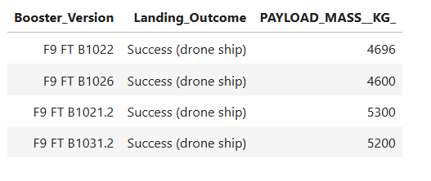
Boosters with Payload Mass of 4000-6000Kg
Names of boosters which have successfully landed on drone ship and had payload mass greater than 4000 but less than 6000

Slide 33
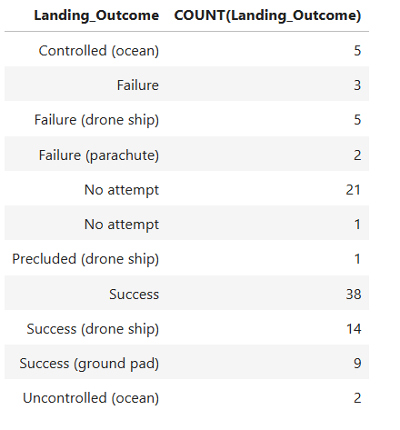
Total Number of Successful and Failure Mission Outcomes
There are more successful than failed landings
Total of 63 successful landings (i.e drone ship, ground pad and success)
Total of 10 failure landing
Five controlled (ocean) and two uncontrolled (ocean) landing outcome
Twenty-two (22) ‘No attempt’ landing outcome

Slide 34
Booster names that have carried the maximum payload mass of 15600kg
Boosters Carried Maximum Payload
F9 B5 B1048.4
F9 B5 B1049.4
F9 B5 B1051.3
F9 B5 B1056.4
F9 B5 B1048.5
F9 B5 B1051.4
F9 B5 B1049.5
F9 B5 B1060.2
F9 B5 B1058.3
F9 B5 B1051.6
F9 B5 B1060.3
F9 B5 B1049.7

Slide 35
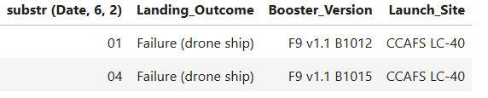
2015 Launch Records
Summary of failed landing outcomes in drone ships, their booster versions, and launch site for the year 2015

Slide 36
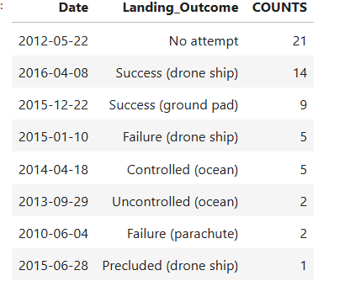
Rank Landing Outcomes Between 2010-06-04 and 2017-03-20
Rockets launched between 2014 and 2016 had high success landing
With 2016 recording 14 counts of successful landing outcome
Two failure landings in a parachute and drone ship during the period
Two counts of uncontrolled (ocean) landing in 2013
Five counts of controlled (ocean) landing outcomes in 2014

Slide 37

Section 3

Slide 38
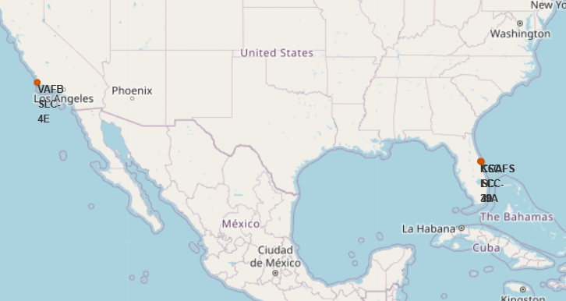
Launch Sites Locations
All Launch sites SpaceX are located closer to the coastal area
VAFB SLC 4E is located by Los Angeles coast
The other three launch sites:
FFCCAFS LC-40
KSC LC-39A
CCAFS SLC-40
Are situated by the Cape Canaveral Space Force Station

Slide 39
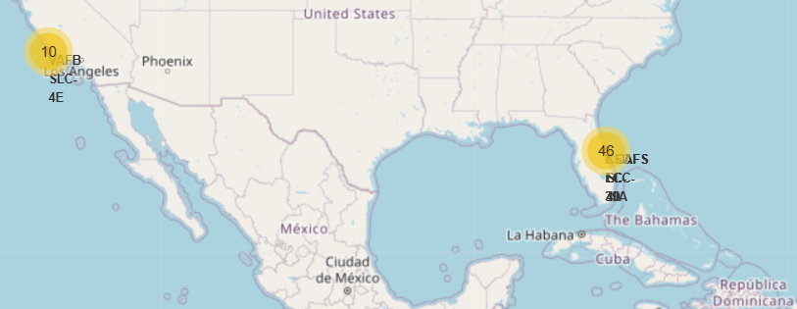
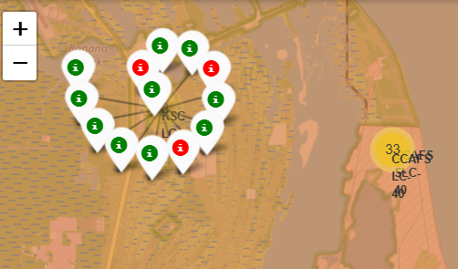
Rocket launch from launch site
The map shows counts of successes and failures launches from specific sites
About 10 rockets were launched from the east compared to 46 from the west stations
“Green” means success and “Red” means failure launch
E.G: KSC LC -39A site shows 10 successful launches and three failed launches
Making it the site with the most successful rockets launches
Whereas, CCAFC LC -40 recorded the high failure rocket launches

Slide 40

Section 4

Slide 41
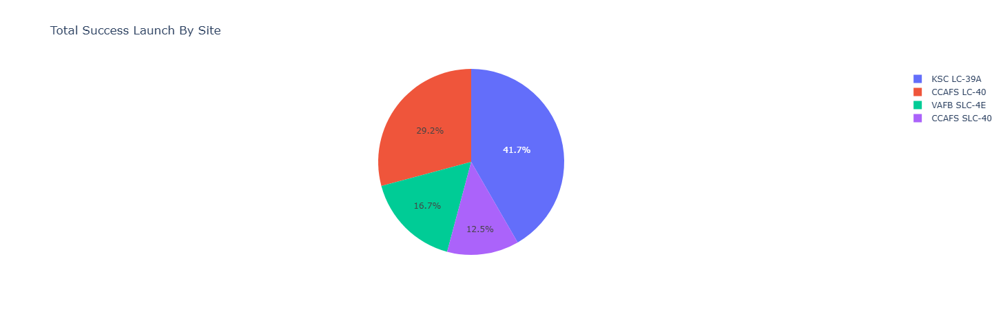
Total Success Launch By Site
KSC LC -39A have a high launch success rate of 41.7%
Followed by CCAFS LC-40 AT 29.2%
Launch sites VAFB SLC-4E and CCAFS SLC-40 total success launches performed below 20%

Slide 42
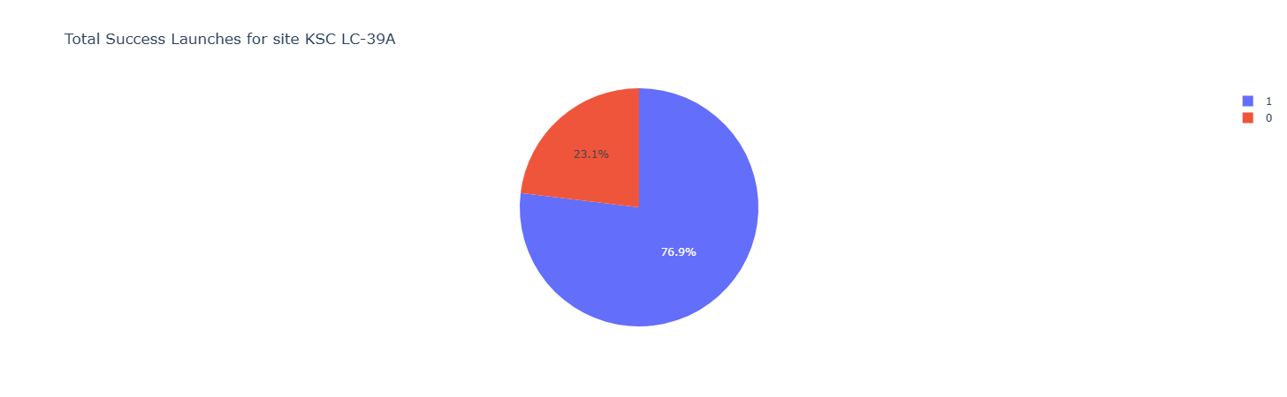
Launch site with Highest Success Rate
There is 76.9% success rate for rockets launched at the KSC LC-39A with 23.1% failure rate
This launch site perform better than the other three sites

Slide 43
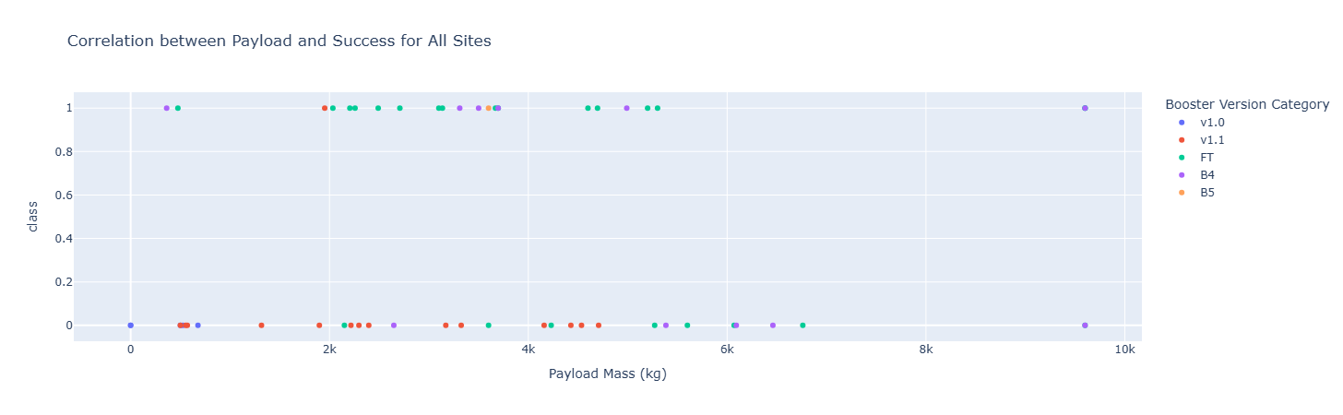
Correlation between the payload and Success for All
Booster versions FT, B4 and B5 indicate higher success rates at a payload mass of 2000-6000kg
Booster version v1.0 and v1.1 recorded relative failure launches for all launching sites
Only version B4 was launched at a payload mass exceeding 9000kg and recorded failure and success

Slide 44

Section 5

Slide 45
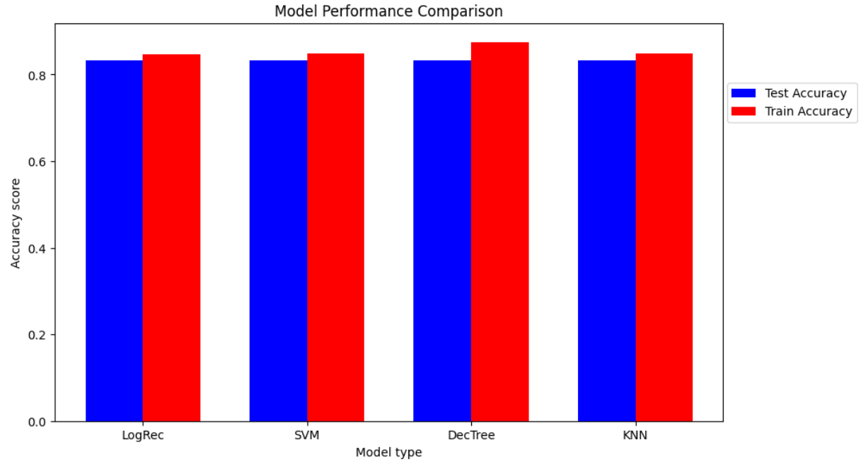
Classification Accuracy
All models have a testing accuracy score of 0.833
SVM and KNN models have training best_score of 0.848
LogRec have training best score of 0.846
DecTree have the highest best score of 0.875 for training data
Therefore, DecisionTree method is the best-performing model to predict launch success

Slide 46
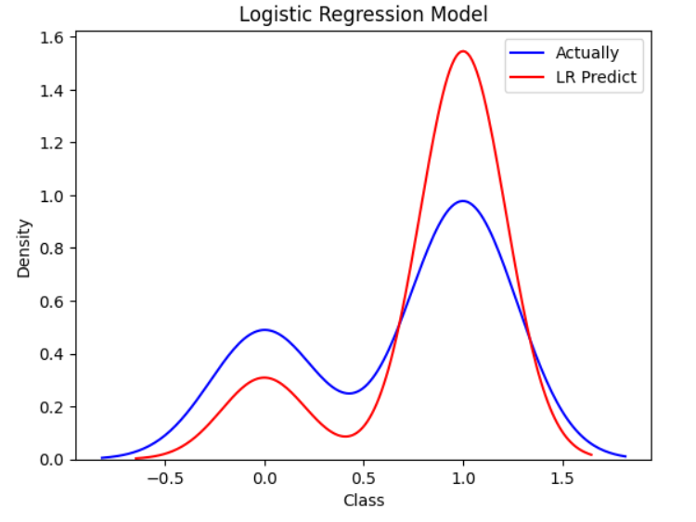
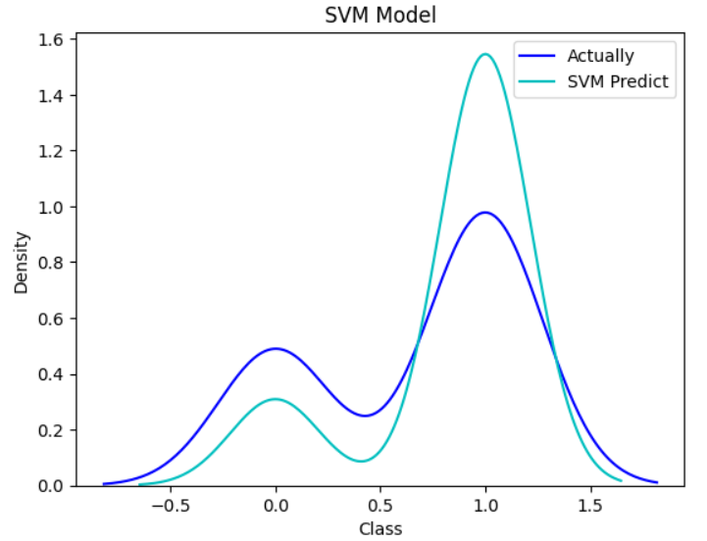
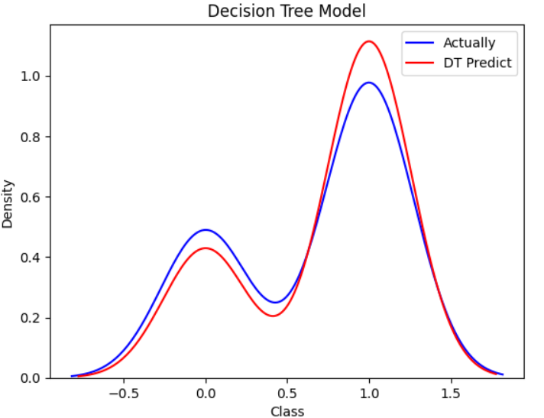
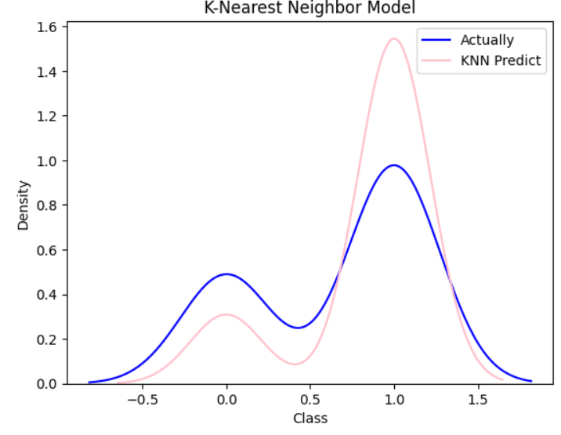
Classification Distribution Plot
From the distribution plots, it is evident that the logistic regression, SVM and KNN models are overffiting and not reliable to predict
The Decision Tree model honours our testing datasets and hence the best-performing model of all four classifications

Slide 47
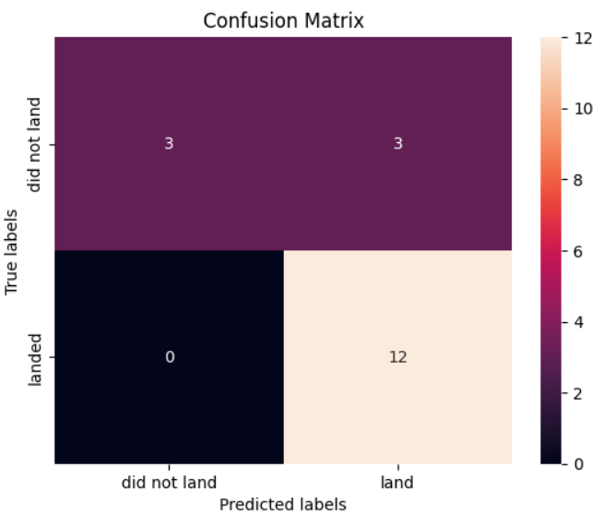
Decision Tree Confusion Matrix
Precision = TP/(TP+FP) = 12/(12+3) =0.8
High-precision of 80% indicates that about 80% of predicted landings did land.
Whereas the remaining 20% did not land.
Recall of 80% shows that the model is good at predicting true rocket landing

Slide 48
Conclusions
The DecisionTree model is the most effective method to predict whether the Falcon 9 will land successfully or not (refer to the appendix for best parameters), and determine launch cost
Factors influencing successful landing outcomes are payload mass, booster version, increased flight number, suitable orbit type and launch site.
Payload mass ranging between 2000-6000kg is most suitable for successfully landing.
ES-L1, GEO, HEO and SSO orbits have a high success landing rate.
Booster versions FT, B4 and B5 are suitable for carrying successful rocket launch and landing.
Rockets launched at KSC LC -39A site perform better and are highly likely to return successful landing outcome

Slide 49
Appendix
Dashboard with dash: qolisile/QoliNgoveni_SpaceX_Dashboard.py at main · QolisilE/qolisile (github.com)
Data visualization: qolisile/QoliNgoveni_Data_Visualization.ipynb at main · QolisilE/qolisile (github.com)
Data collection (web scraping): qolisile/QoliNgoveni_SpaceX_Data wrangling.ipynb at main · QolisilE/qolisile (github.com)
Data Source(Wikipedia): https://en.wikipedia.org/wiki/List_of_Falcon_9_and_Falcon_Heavy_launches
Data Collection API: qolisile/QoliNgoveni_spacex-data-collection-api.ipynb at main · QolisilE/qolisile (github.com)
Dashboard: qolisile/QoliNgoveni_SpaceX_Dashboard.py at main · QolisilE/qolisile (github.com)
Folium Map: qolisile/QoliNgoveni_folium_launch_site_location.ipynb at main · QolisilE/qolisile (github.com)
Machine Learning: qolisile/QoliNgoveni_SpaceX_Machine Learning Prediction_Part_5.ipynb at main · QolisilE/qolisile (github.com)
SQL EDA: qolisile/QoliNgoveni_SQL EDA.ipynb at main · QolisilE/qolisile (github.com)

Slide 50
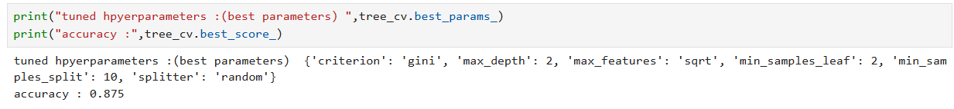
Appendix
Best parameters for Decision Tree

Slide 51


